Slide 1

Allergen Awareness & Management in the workplace - Training for all level of employees
Objective:
Understand what food allergens are and their health impact.
Recognize macadamia nuts as a regulated allergen.
Comply with local and international allergen regulations (e.g., R146 in South Africa, Codex, EU 1169/2011).
Know how FSSC 22000 v6 addresses allergen management.
Apply correct handling, cleaning, labelling, and cross-contact prevention procedures.

Slide 2
What Are Food Allergens?
Food allergens are proteins in food that cause abnormal immune responses in sensitive individuals.
Common Allergens in South Africa:
Peanuts
Tree nuts (including macadamia nuts)
Eggs
Milk
Fish
Shellfish
Soy
Wheat (gluten)
Severity of different Allergen, thus Peanuts are the most severe allergen and will not be allowed on the site.
Gluten & Sulphur Dioxide is considered as intolerances.

Slide 3
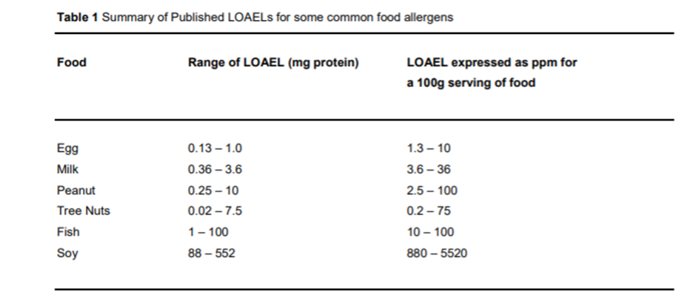
Critical Limits / Lowest Observed Adverse Effect Levels for different allergens:
The lowest-observed-adverse-effect level (LOAEL), or the lowest-observed-adverse-effect concentration (LOAEC), is the lowest concentration or amount of a substance found by experiment or observation that causes an adverse alteration of morphology, function, capacity, growth, development, or lifespan of a target organism distinguished from normal organisms of the same species under defined conditions of exposure.

Slide 4
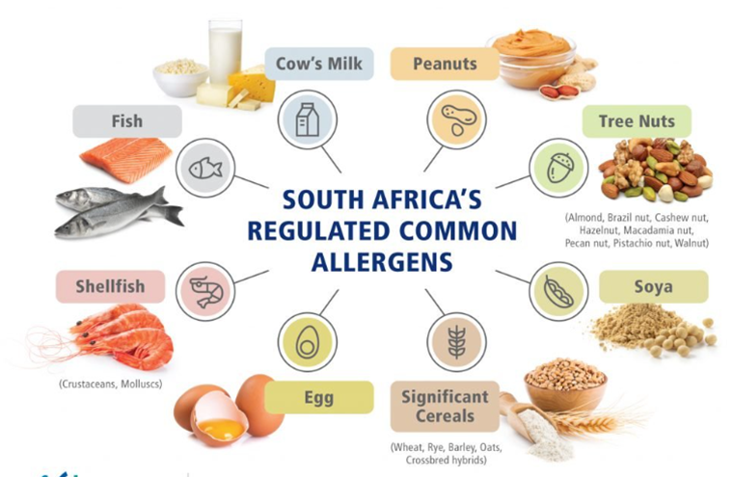
This facility handles:
Macadamia Nuts that contain:
Tree Nut Allergens

Slide 5
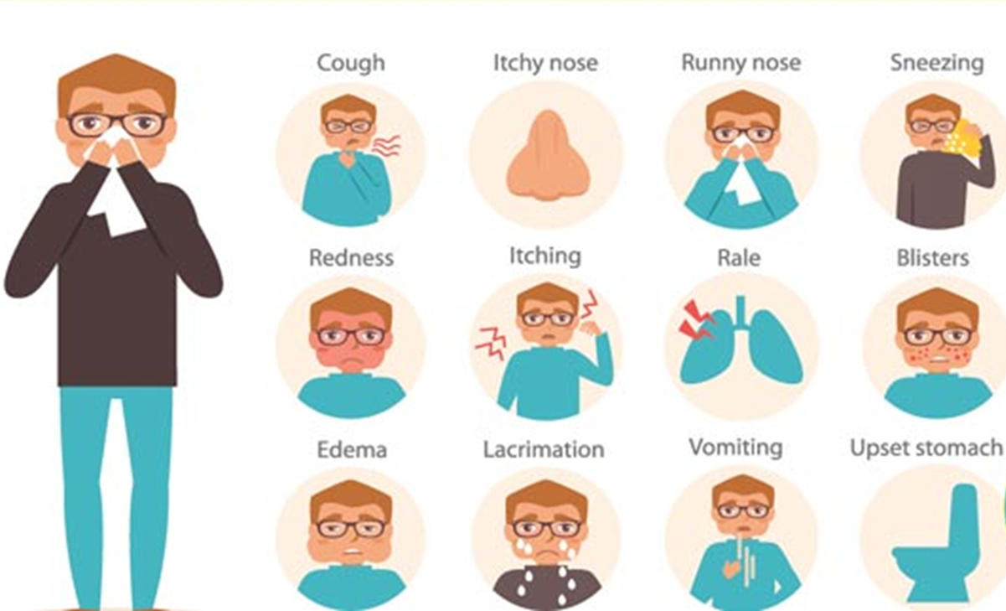
In South Africa (per R146):
Macadamia nuts are considered a priority allergen and must be declared.
Symptoms of Allergic Reaction:
Mild: Rash, itching, sneezing
Severe: Anaphylaxis, swelling of the throat, respiratory distress
Why It Matters:
Macadamia nuts are a tree nut allergen.
Even trace amounts can trigger severe reactions in allergic individuals.

Slide 6
Your Facility:
Only handles macadamia nuts, but still requires robust allergen controls to:
  Prevent cross-contact (e.g., with staff food)
  Protect consumer health
  Maintain certification
Local South African Law:
R146 (Regulations Relating to the Labelling and Advertising of Foodstuffs):
  Mandatory declaration of tree nuts (macadamia included) on packaging.
  Allergen statements must be clear and legible.

Slide 7
Allergen Control Practices
1. Zoning and Facility Design
Dedicated areas for processing macadamia nuts.- All areas will only be handling macadamia nuts.
Clearly marked allergen zones.
Prevent introduction of other allergens (no outside food in processing areas).
2. Personnel Practices
Staff may not bring any food into production areas.
Staff may not bring food onto the site that is not allowed according to the company’s allergen policy.
Uniforms must be laundered professionally to avoid cross-contact.
Handwashing and PPE (gloves, aprons, hairnets) mandatory.
Pre-approval of maintenance chemicals, food grade grease and lubricants. (Ensure that none include allergens)

Slide 8
3. Cleaning & Sanitation
Use validated cleaning procedures even though only one allergen is processed.
Cleaning verification and validation (e.g., protein swabs)- Will be done on risk base
Maintain sanitation logs
4. Packaging & Labelling
Labels must state “Contains: Macadamia nuts” clearly.
Prevent label mix-up errors through:
  Barcode/vision verification
  Segregation of packaging materials

Slide 9
5. Storage & Handling
Raw and finished product storage areas clearly labelled.
Avoid cross-contact through:
  Proper palletizing
  Sealed packaging
Employee Responsibilities
Always follow hygiene and allergen procedures.
Report any contamination or label issues.
Never bring in outside food or wear contaminated clothing.
Read and understand all product labels and allergen signs.

